Slide 1
CS 4350: Fundamentals of Software Engineering CS 5500: Foundations of Software Engineering Lesson 5.1 Testing Introduction
Jon Bell, John Boyland, Mitch Wand
Khoury College of Computer Sciences
© 2021 Jonathan Bell, John Boyland and Mitch Wand. Released under the CC BY-SA license

Slide 2
Learning Objectives for this Lesson
By the end of this lesson, you should be able to:
Describe the elements of a test and how they are used;
State Dijkstra’s law and its relevance;
Classify tests by purpose, scope and size;
Explain why test automation is important.
We will revisit these at the end of the lesson.

Slide 3
Working Definition
Software Testing is the process of checking if software meets certain concrete requirements
“certain” – a finite set
“concrete” – particular, not symbolic
Testing is carried out by execution of the software.
Next: definitions “SUT” and “Test”

Slide 4
SUT = System Under Test
The “System Under Test” consists of its
Inputs
State
Outputs
State Change
(Other) Behavior
System
State
State Change
Inputs
Outputs
Behavior

Slide 5
Test
A Test for a SUT consists of
Given [a certain state in the SUT],
When [certain inputs are presented],
Then [certain outputs, state change and behavior are expected].
Example:
it('should set the coveyRoomID property', () => {
const roomsStore = CoveyRoomsStore.getInstance();
const roomName = nanoid();
const roomController = roomsStore.getControllerForRoom(roomName);
expect(roomController.coveyRoomID)
.toBe(roomName);
});
Given
When
Then

Slide 6
Running a Test
Construct the situation:
Set up SUT to get the state ready
[Optional: Prepare collaborators]
Apply the operation inputs.
Check the outputs, verify the state change, handle the behavior
Handle exceptions,
Time-Out to handle nontermination,
Post-check with collaborators.

Slide 7

Dijkstra’s Law
“Program testing can be used to show the presence of bugs, but never to show their absence!” – Edsger Dijkstra
The state space of a SUT is (usually) infinite, but testing can only execute a finite number of tests.
Even if the state space is finite, it may still be too large to make exhaustive testing feasible.
And this ignores the fallibility of tests. What if the tests are in error?

Slide 8
Classifying Tests
We can classify tests according to several cross-cutting dimensions:
Scope: What sort of thing is the SUT?
Purpose: Why are we testing?
Size: What resources does testing need?
How: How is testing performed?

Slide 9
Test Scope
Unit tests: SUT = a single method/class/object
Integration tests: SUT = combinations of units, a subsystem
System tests: SUT = whole system being developed

Slide 10
Test Purpose
Acceptance Test
Customer-level requirement testing
Validation: Are we building the right system ?
Functional Test
“Black-Box” testing
Specification Testing
Structural Test
“White-Box” testing
Exercising the code
Regression Test
Prevent bugs from (re-)entering during maintenance.
These purposes affect how we evaluate a test suite.

Slide 11
Test Size
Small: run on a single process, no blocking I/O
Fast to run; can be run automatically and frequently
Medium: run on a single machine, no network I/O (only localhost); “hermetic”
May be slower; delayed to overnight runs
Large/Enormous tests: run on a network.
May have serious $$$ cost in network services or personnel.
See SoftEng @ Google Chapter 11
https://learning.oreilly.com/library/view/software-engineering-at/9781492082781/ch11.html#testing_overview

Slide 12
Manner of Testing
Automated tests can be run without supervision
Suitable for frequent automated runs
Manual tests require a human to run and evaluate
A human may be needed to check UI elements
Tests may be ill-defined and nondeterministic
E.g. trying to “break” software
Customer-facing tests require an intermediary to evaluate as well as the customer to use the software.

Slide 13
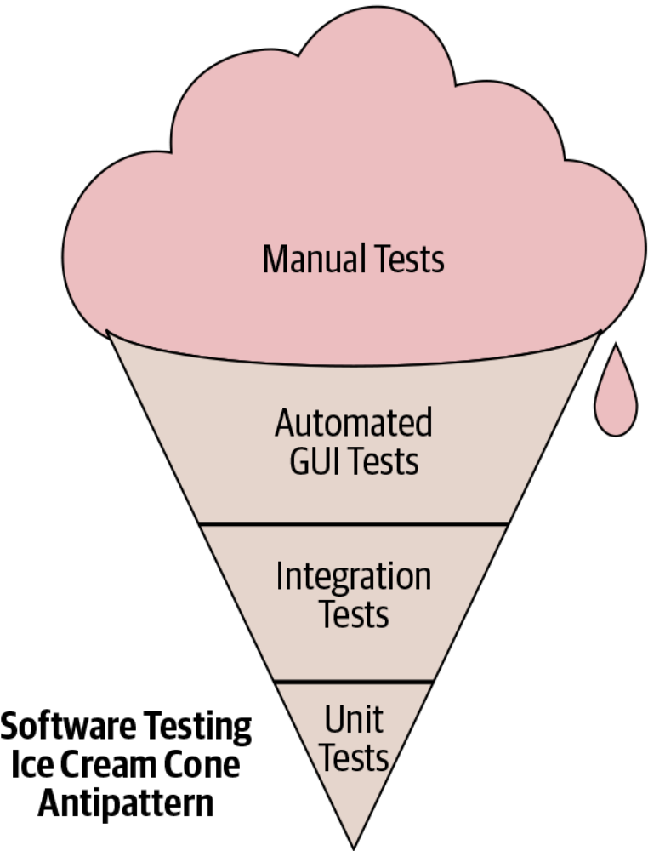
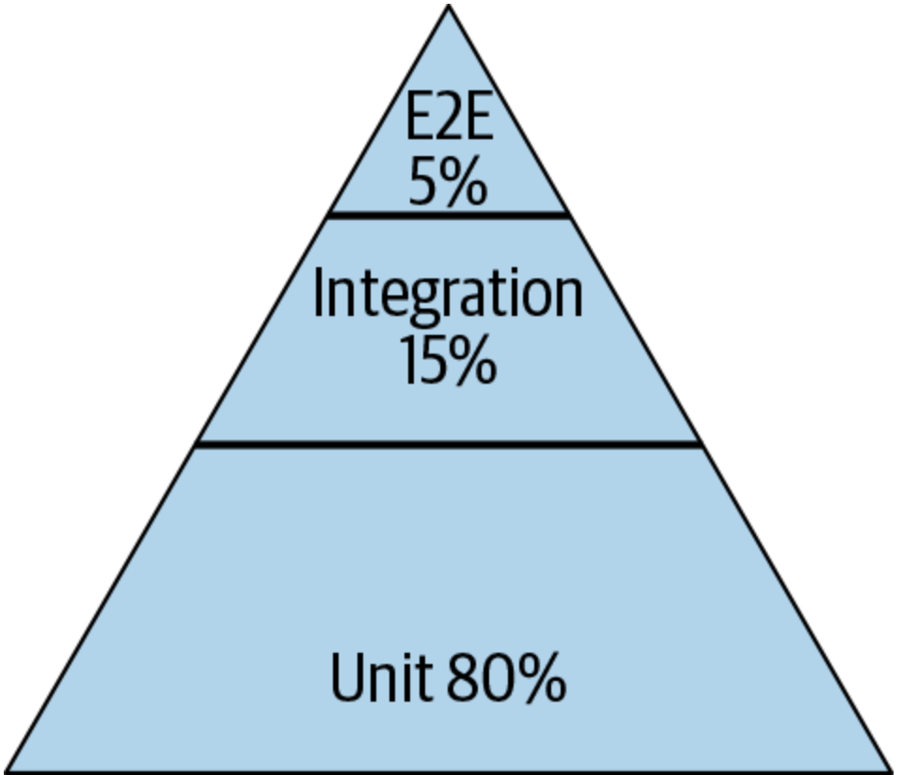
Test Distribution (Size/Scope/Manner)
Pyramid
Test Pattern
From SoftEng @ Google Chapter 11
https://learning.oreilly.com/library/view/software-engineering-at/9781492082781/ch11.html#testing_overview

Slide 14
Review
Now that you've studied this lesson, you should be able to:
Describe the elements of a test and how they are used;
State Dijkstra’s law and its relevance;
Classify tests by purpose, scope and size;
Explain why test automation is important.

Slide 15
Looking Forward
In our next lesson, we’ll discuss “Test-Driven Development”

